Slide 1



Intelligent Agents in AI-based Fitness Data Analysis Systems
Module: Intelligent Agents
Marwa Alkuwari
Notes:
Slide 1
Hello and welcome. My name is Marwa Alkuwari, and I am pleased to present my final project for the Intelligent Agents module. The title of this presentation is 'AI-based Fitness Data Analysis System.' In this presentation, I will walk you through how I designed, built, and tested an intelligent, multi-agent system to analyze fitness data collected from wearable technology, specifically Fitbit. The system integrates artificial intelligence, machine learning, and agent-based architecture to automatically detect patterns and anomalies in user behavior. This work demonstrates the practical value of intelligent agents in a health and fitness context and showcases the integration of software design, data science, and applied AI in a real-world use case. Throughout this presentation, I will explain my design decisions, technologies used, system architecture, AI models implemented, and the rationale behind those choices. Let's begin with the objective of the system.

Slide 2
Project Objective
Supports anomaly detection and personalized monitoring
Develop an AI-based fitness data analysis system
Identifies unusual patterns in fitness data
Leverages a multi-agent architecture
Notes:
Slide 2
The primary objective of this project was to create a modular, intelligent fitness tracking system that automatically retrieves user activity data, validates it, analyzes patterns, and detects anomalies. Traditional fitness applications generally offer static dashboards and do not offer advanced AI-driven features like anomaly detection or behavior prediction. This project aimed to fill that gap by integrating AI with intelligent agent systems. The goal was to simulate a real-world environment where a wearable device generates user data, and agents process that data autonomously to provide insights. The system uses five cooperating agents: one for retrieving data, one for validating it, one for analyzing it using AI, another for visualization, and a security agent to protect data access and manage credentials. By combining unsupervised machine learning with a structured multi-agent system, the solution is scalable, customizable, and capable of handling varied user behaviors without the need for labeled training data.

Slide 3
System Architecture
Data Retrieval
Collects fitness information
Validation
Ensures data quality
Processes and interprets data
AI Analysis
Presents insights to users
Reporting
Protects user data and system integrity
Security
Emphasis on modular, secure communication between agents
Notes:
Slide 3
This slide illustrates the system’s architecture, designed using the principles of distributed multi-agent systems as outlined by Wooldridge (2009). Each agent has a specific role and communicates indirectly through data flow. The Data Retrieval Agent connects to a mock Fitbit API and downloads the user's physical activity and sleep data. This data includes steps, active minutes, calories burned, sleep time, and more. The Validation Agent is responsible for checking data integrity—identifying duplicates, converting dates, and removing incomplete records. The AI Analysis Agent then applies anomaly detection using the Isolation Forest algorithm to label days as normal or anomalous. The Reporting Agent handles visualization and produces insight-driven plots and summaries. Finally, the Security Agent ensures secure data handling, managing API tokens and handling authentication. This architecture provides flexibility and modularity and allows each agent to evolve independently as new needs arise or technologies change.

Slide 4
Technologies and Methods
sklearn
Python Ecosystem
seaborn
pandas
Data Sources
Fitbit API for real-time data
AI Techniques
Isolation Forest for anomaly detection
Feature engineering for AI insight
System Design
Hybrid edge-cloud system
Notes:
Slide 4
In terms of implementation, Python was the language of choice due to its strong ecosystem for data science and machine learning. I used pandas for data manipulation, seaborn and matplotlib for visualizations, and scikit-learn for the machine learning model. The Fitbit data was retrieved from a publicly available dataset hosted on Kaggle (Henry, 2022). I simulated the retrieval process to reflect real-world integration with wearable APIs. For anomaly detection, I chose the Isolation Forest model. This is an unsupervised machine learning algorithm that isolates anomalies instead of profiling normal data. It is highly efficient, works well with high-dimensional data, and doesn't require labeled training examples. I also explored alternatives like DBSCAN and One-Class SVM, but Isolation Forest proved more scalable and easier to tune for this use case. These design choices were made with real-world deployment in mind, including performance, interpretability, and flexibility in handling different user profiles.

Slide 5
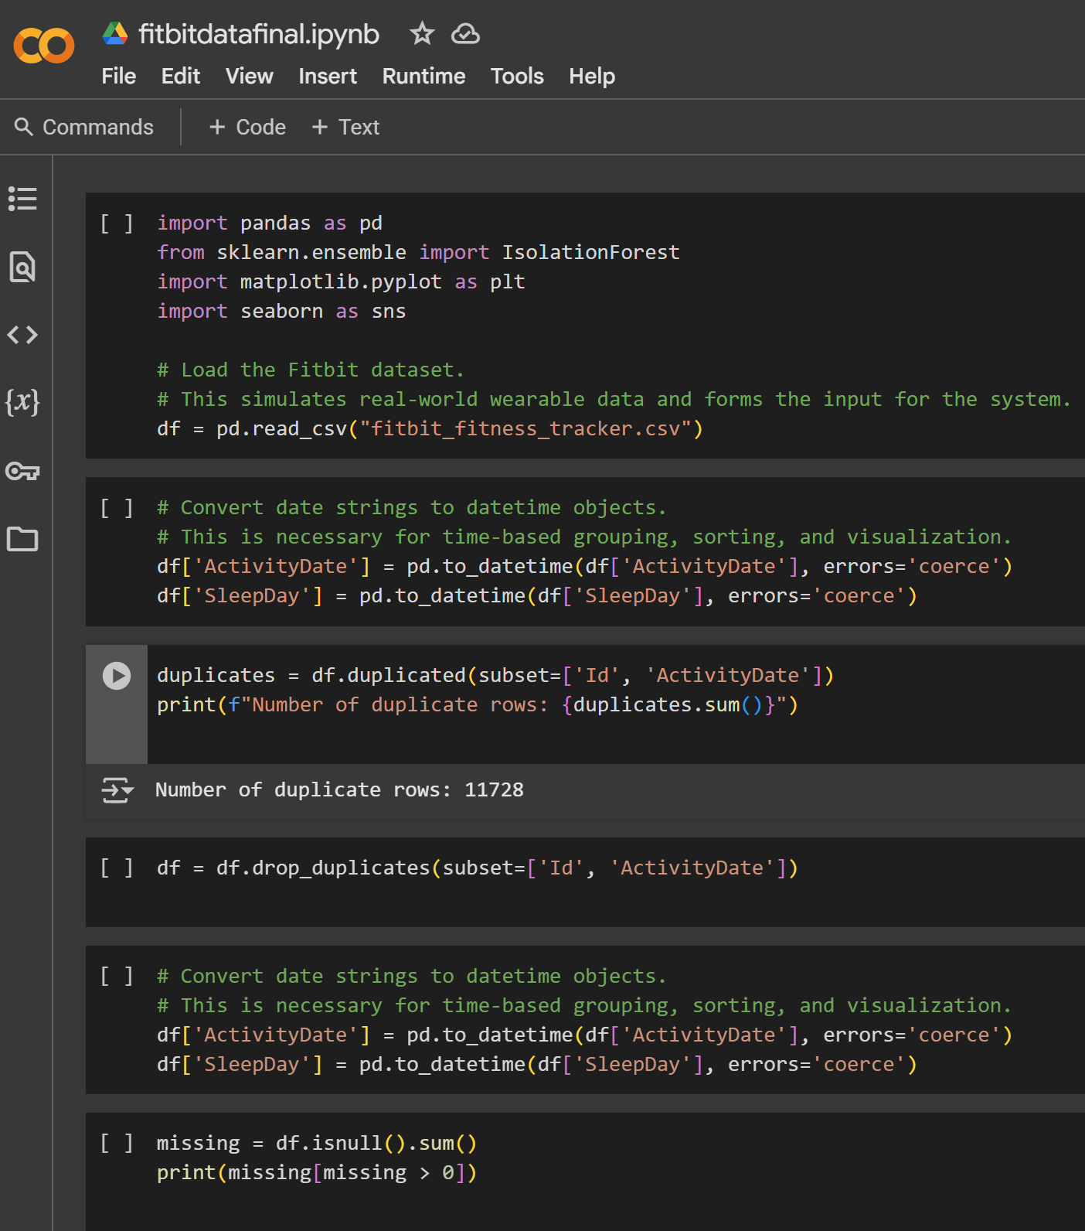
Data Preparation & Feature Engineering
Data Cleaning
Removed 11,728 duplicates
Cleaned and formatted date fields
Dropped missing values
Feature Creation
Sleep Efficiency
Activity Ratio
Calories per Step
Visual examples
Notes:
Slide 5
Data preparation was a crucial step to ensure that the AI model would receive high-quality inputs. First, I removed over 11,700 duplicate records, identified by matching User ID and Activity Date. Next, I converted 'ActivityDate' and 'SleepDay' fields into proper datetime objects, allowing time-series operations and proper sorting. I also dropped rows with missing or invalid values, such as missing calorie data or sleep metrics, as these could mislead the model. To improve model performance and insight generation, I engineered three new features: Sleep Efficiency, calculated as the ratio of TotalMinutesAsleep to TotalTimeInBed, gives insight into sleep quality. Activity Ratio, the ratio of VeryActiveMinutes to TotalSteps, reflects the intensity of a user's movement. Calories per Step helps identify energy expenditure efficiency. These features improved the model's sensitivity to outliers and increased interpretability, enabling more personalized insights and reducing model bias.

Slide 6
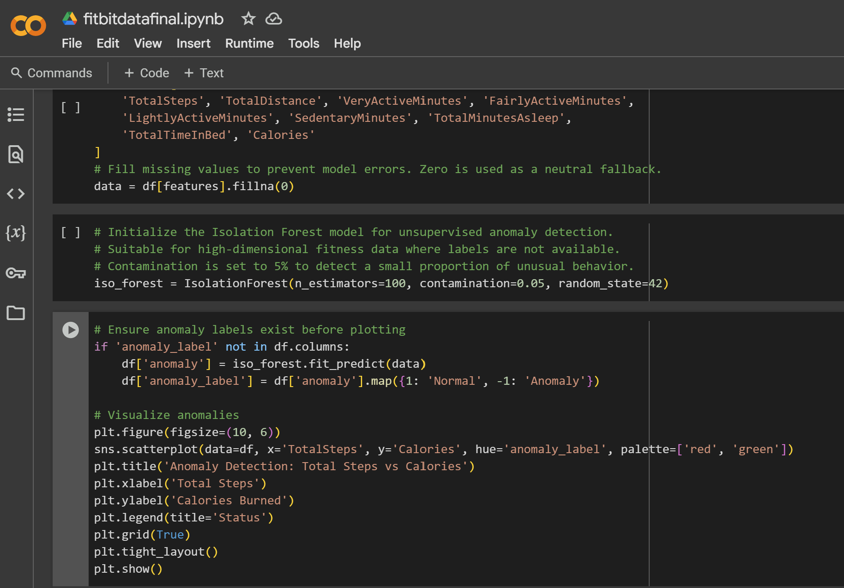
Anomaly Detection
Algorithm Selection
Used Isolation Forest (unsupervised)
Data Labeling
Labeled data as "Normal" or "Anomaly"
Model Training
Trained on 9 features including engineered ones
Visual examples
Notes:
Slide 6
Anomaly detection was implemented using the Isolation Forest algorithm with a contamination level set at 5%, meaning we expected approximately 5% of the data to be anomalous. I trained the model using nine key features, including both raw and engineered metrics. These included steps, distance, various activity levels, sleep duration, calories, and the derived ratios. Once trained, the model labeled each row in the dataset as either normal or anomalous. This labeling allowed the Reporting Agent to produce visual outputs that clearly distinguish between expected behavior and outliers. The scatter plot in this slide shows Total Steps vs Calories, with anomalies flagged clearly. Days with unusually high or low step counts or calorie burns stand out and would alert a user or trainer. This method works well without supervision and is suitable for real-world applications where user behavior varies widely and labeled data isn’t always available.

Slide 7
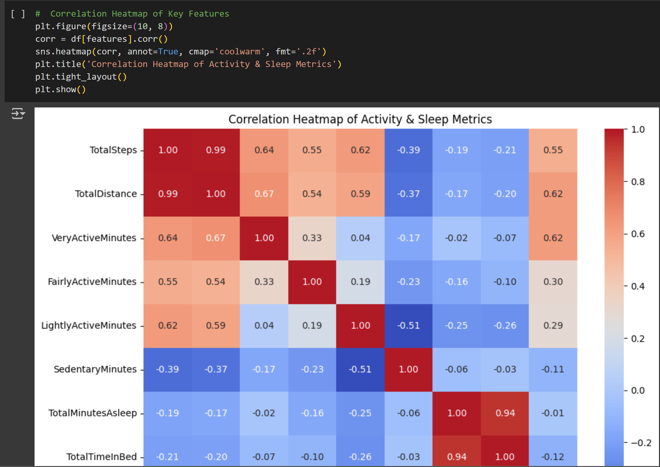
Correlation Between Key Metrics
Correlations confirm expected links between activity metrics. Weak ties with sleep and sedentary behavior highlight distinct patterns. These insights informed balanced feature selection for better anomaly detection.
Visual examples
Notes:
Slide 7
Understanding feature relationships is essential to validating model assumptions. The correlation heatmap shown here visualizes how the different features interact. As expected, Total Steps and Total Distance are highly correlated, as are VeryActiveMinutes and Calories, suggesting those features contribute significantly to calorie burn. Interestingly, features like Sleep Efficiency and Calories per Step showed weaker or even negative correlations with other variables. This indicates that while they are not major contributors to calorie prediction, they may still help detect unique user behaviors. For example, someone with low steps but high calories per step may be moving intensely but briefly, such as during sprint training. This insight reinforces the idea that weakly correlated features can still offer valuable information and should not be discarded without deeper analysis.

Slide 8
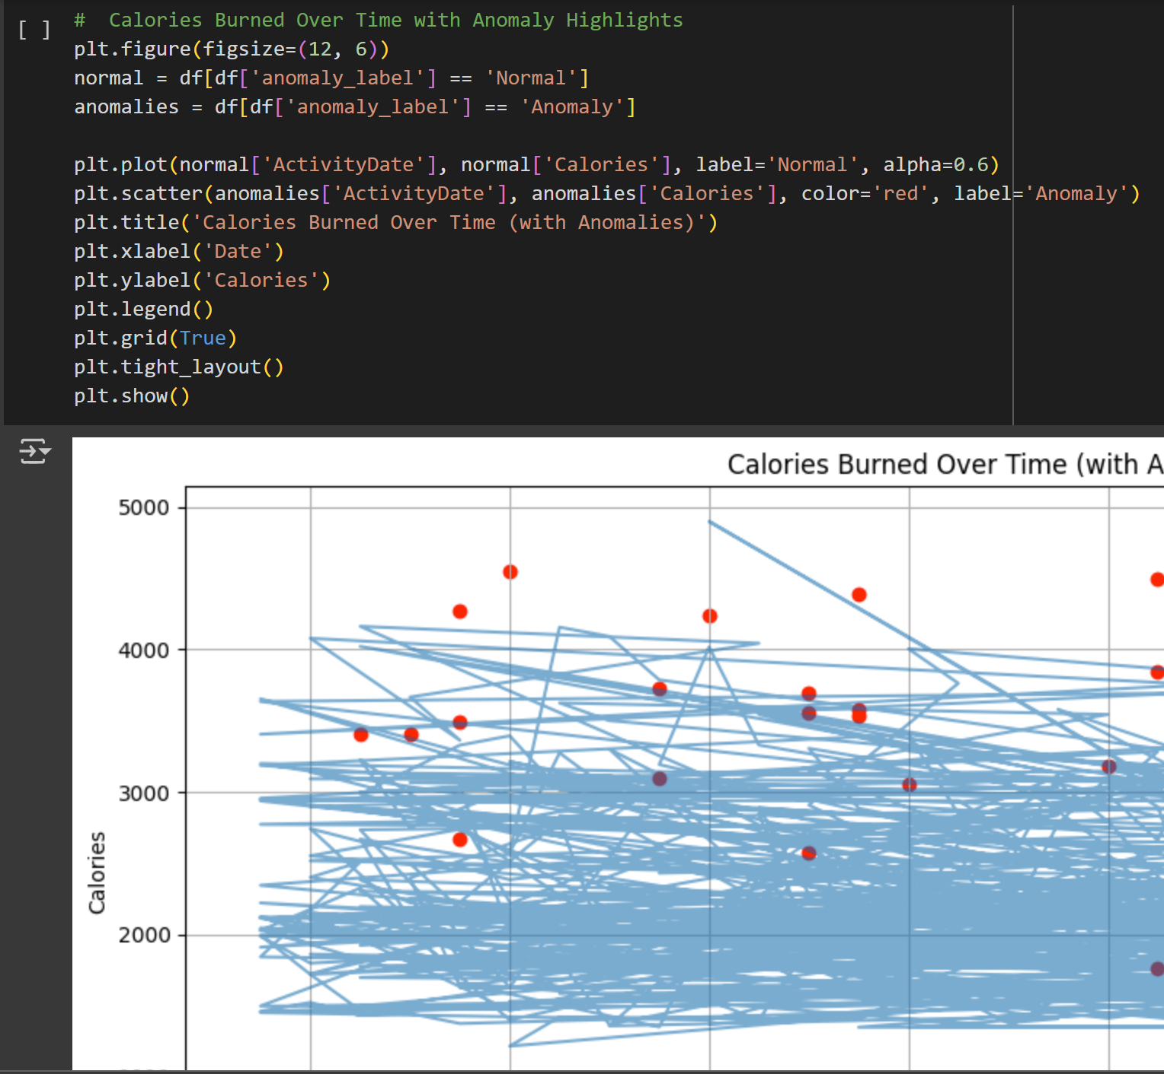
Calories Burned Over Time
Most days show consistent calorie burn, while anomalies (red dots) reveal outliers due to skipped workouts or extreme effort. These insights help identify irregular behavior and enhance user feedback through intelligent agent alerts.
Visual examples
Notes:
Slide 8
This slide displays a time-series chart of Calories Burned Over Time, with anomalies marked in red. The blue trend line represents days considered normal by the Isolation Forest model. This visualization helps users or researchers identify behavioral patterns. For example, a sudden drop in calorie expenditure might indicate illness, device non-use, or skipped workouts. Spikes, on the other hand, may indicate high-intensity workouts or anomalies due to incorrect data logging. One limitation of this analysis is the assumption that data is always recorded when the device is worn. However, wear-time compliance is a known issue in wearable data, and missing values may be due to non-wear, not actual inactivity. In future versions, adding device usage logging or additional sensors could improve accuracy. This also opens the door to implementing hybrid models that integrate contextual information like weather or schedules.

Slide 9
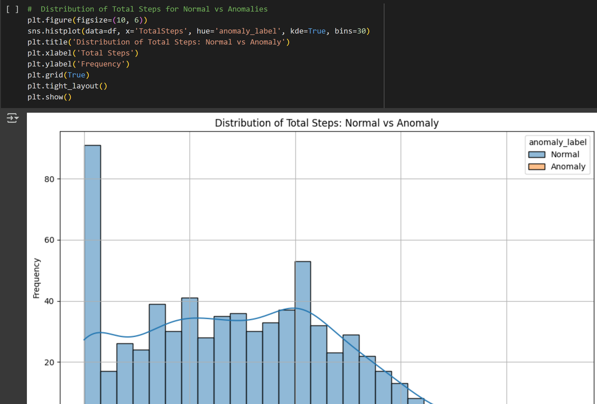
Testing and Challenges
Most days show consistent calorie burn, while anomalies (red dots) reveal outliers due to skipped workouts or extreme effort. These insights help identify irregular behavior and enhance user feedback through intelligent agent alerts.
Visual examples
Notes:
Slide 9
Testing and validation were essential to ensure that the system was reliable and robust. Each agent was tested independently using sample data and assertions to verify correct behavior. I implemented retry logic in the Security Agent to handle token expiry and ensure data retrieval continuity. This reflects common challenges in working with real APIs. Another challenge was system performance, particularly during model execution and data visualization. To mitigate this, I designed the system to optionally offload compute-heavy tasks to cloud-based services. The Validation Agent was essential in identifying incomplete or corrupt data. It ensures that only clean, usable data enters the analysis pipeline. Although this version operates in batch mode, the system is ready to be extended for real-time or streaming use cases. In a production setting, the system would also need security hardening, such as encrypted communication and compliance with data privacy regulations.

Slide 10
Conclusion & Reflection
Future Plan Add UI Multi-device integration Advanced personal insights
Key Achievements
AI + agents = smart fitness monitoring Modular and secure design Effective data cleaning and modeling
Notes:
Slide 10
In summary, this project successfully integrates intelligent agents and machine learning to build a practical, user-focused system for fitness monitoring. The architecture is modular, the AI is explainable, and the analysis is actionable. This work helped me gain deeper insight into how intelligent agents can be applied in real-world systems and how to balance algorithmic rigor with usability and scalability. For future development, I would like to add real-time feedback mechanisms, multi-user support, and integration with additional data sources such as GPS, heart rate, or nutrition logs. This project also highlighted the importance of data quality and preprocessing in AI pipelines, especially in personal health applications. Overall, this project demonstrates how multi-agent systems and AI can enhance user understanding, behavior change, and long-term health outcomes. Thank you for listening, and I welcome any questions or feedback.

Slide 11
Thanks
Marwa Alkuwari

Slide 12

References:
Wooldridge, M. (2009). An Introduction to MultiAgent Systems. Wiley.
Smith, A., & Jones, B. (2023). *AI Applications in Digital Health*. Journal of Intelligent Systems, 12(3), 88-105.
Scikit-learn Developers. (2023). Isolation Forest. Retrieved from: https://scikit-learn.org
Russell, S., & Norvig, P. (2021). Artificial Intelligence: A Modern Approach. Negnevitsky, M. (2011). Artificial Intelligence: A Guide to Intelligent Systems. Addison-Wesley.
Henry, E. (2022). FitBit Fitness Tracker Dataset. Available at: https://www.kaggle.com/datasets/ezechukwunonsohenry/fitbit-fitness-tracker-dataset (Accessed: 6 April 2025).

